Slide 1


Slide 2
NEW

Slide 3

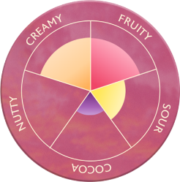
Notes:
Deze vernieuwende ervaring ervaring die doet denken aan een frisse Pink Lemonade met bubbels op het strand. Euphoria geeft je zijdezacht lemon ijs, met een frambozen sorbet core, omhuld door een dikke laag krakende witte Magnum chocllade, met knapperige frambozen stukjes en verassende popping candy, voor een prikkelende ervaring.

Slide 4
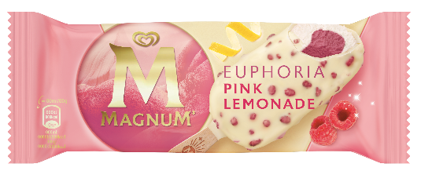
AANTREKKELIJKE VERPAKKING – UN EMBALLAGE ATTRACTIF
OOH Wrapper

Slide 5
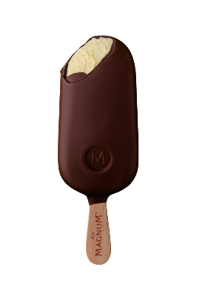
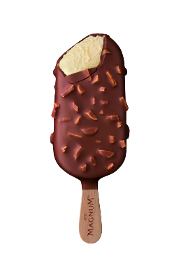
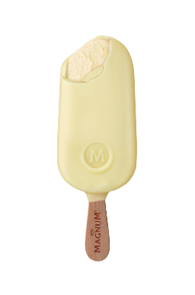
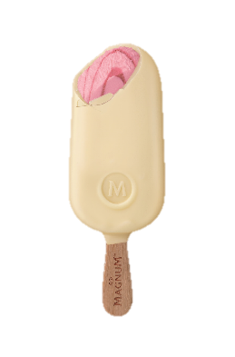
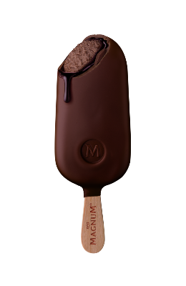



MAGNUM OOH 2024
SWITCH
SWITCH
SWITCH
SWITCH
Classic
120 ml
Almond
120 ml
White
120 ml
Strawberry White
110 ml
Almond Vegan
90 ml
OUT
SWITCH
Double Chocolate
88ml
Double Gold
Caramel Billionaire
85 ml
Bomboniera
6x12 ml
Starchaser
85ml
Sunlover
85ml

Slide 6
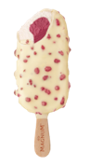
MAGNUM OOH 2024
NEW
NEW
NEW
NEW
NEW
Classic
110ml
Almond
110 ml
White
110 ml
Strawberry White
100 ml
Euphoria
90 ml
NEW
Double Chocolate
88ml
Double Gold
Caramel Billionaire
85 ml
Bomboniera
6x12 ml
Starchaser
85ml
Almond Vegan
90 ml
Notes:
Bomboniera: no change in volume or price, but making use of better chocolate

Slide 7

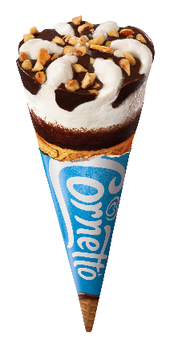
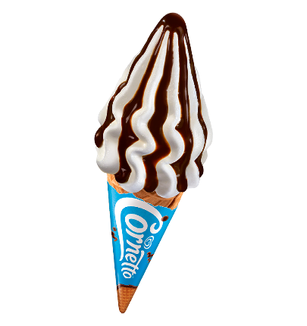
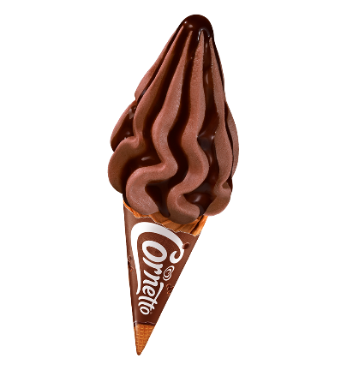
ASSORTIMENT ooh 2024
SKU DB 202 FY
NEW
Cornetto Soft Stracciatella 140ml

Slide 8




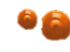

NEW
DELICIOUSLY SOFT ICE CREAM
WITH SALTED CARAMEL SAUCE
New sauce, more dense than ever before in soft
AND A CRUNCHY new wafer: meet the new cocoa wafer
WITH A SAUCE CORE
and rfa vanilla

Slide 9




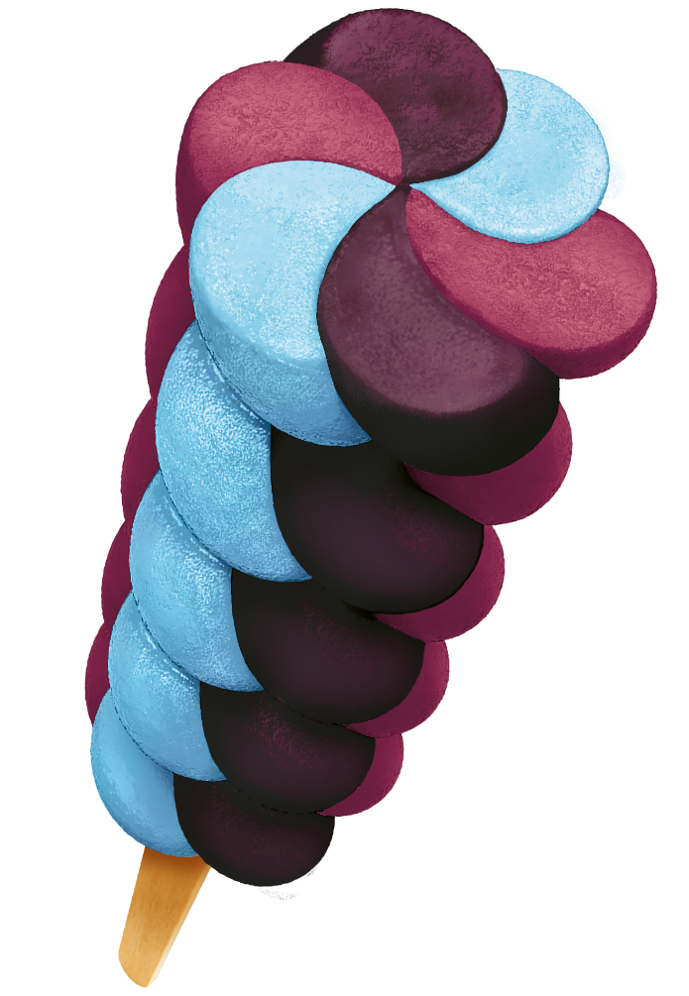



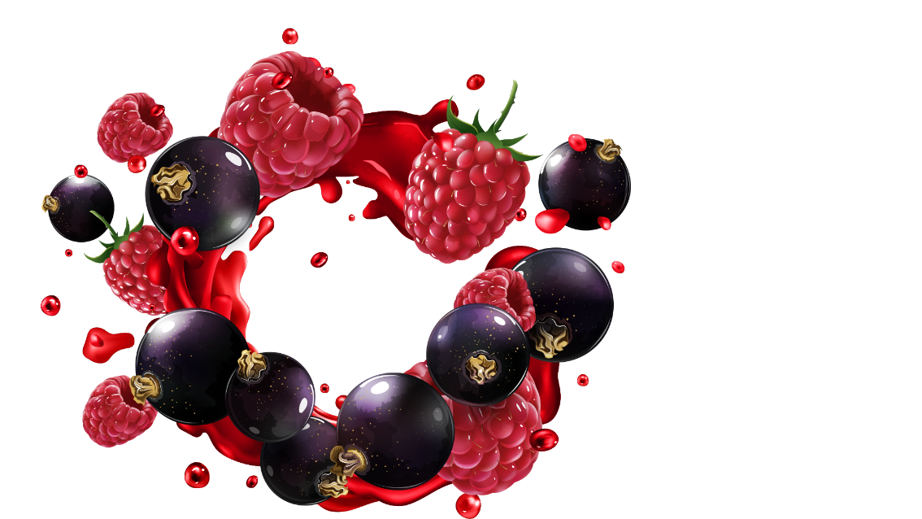
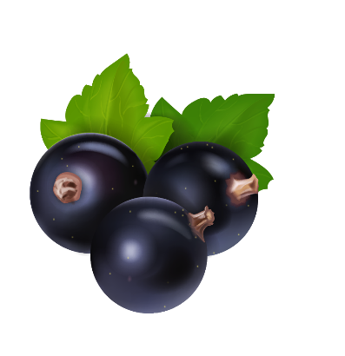

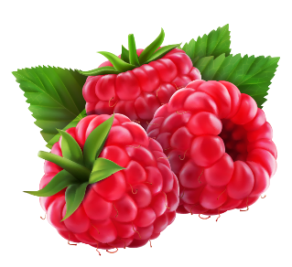
Cosmixx
NEW
VERFRISSENDE BOSBES
ROMIGE ZWARTE BES
FRAMBOOS
Notes:
Voiceocer: The NEW Twister Cosmixx features the bursting flavors of refreshing blueberries, blackcurrant, and raspberries. Our R&D experts developed a ground-breaking technology that colors your tongue. With each lick or bite, the tongue becomes dark purple, adding an extra layer of fun and excitement for all kids!

Slide 10




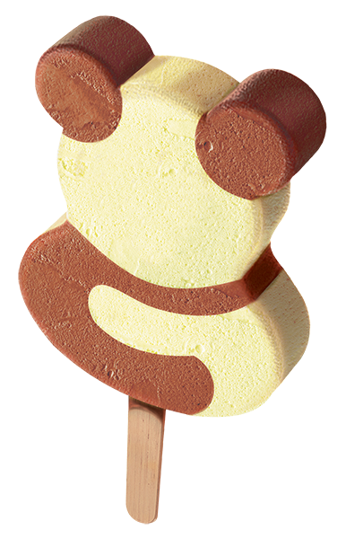




Jungle Party
NEW
Affordable ice cream
Most popular flavors
Chocolade
VANILLE

Slide 11
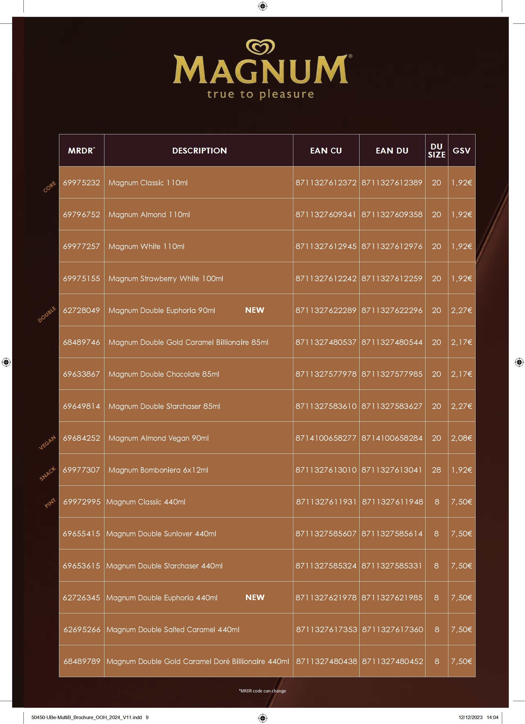

Slide 12
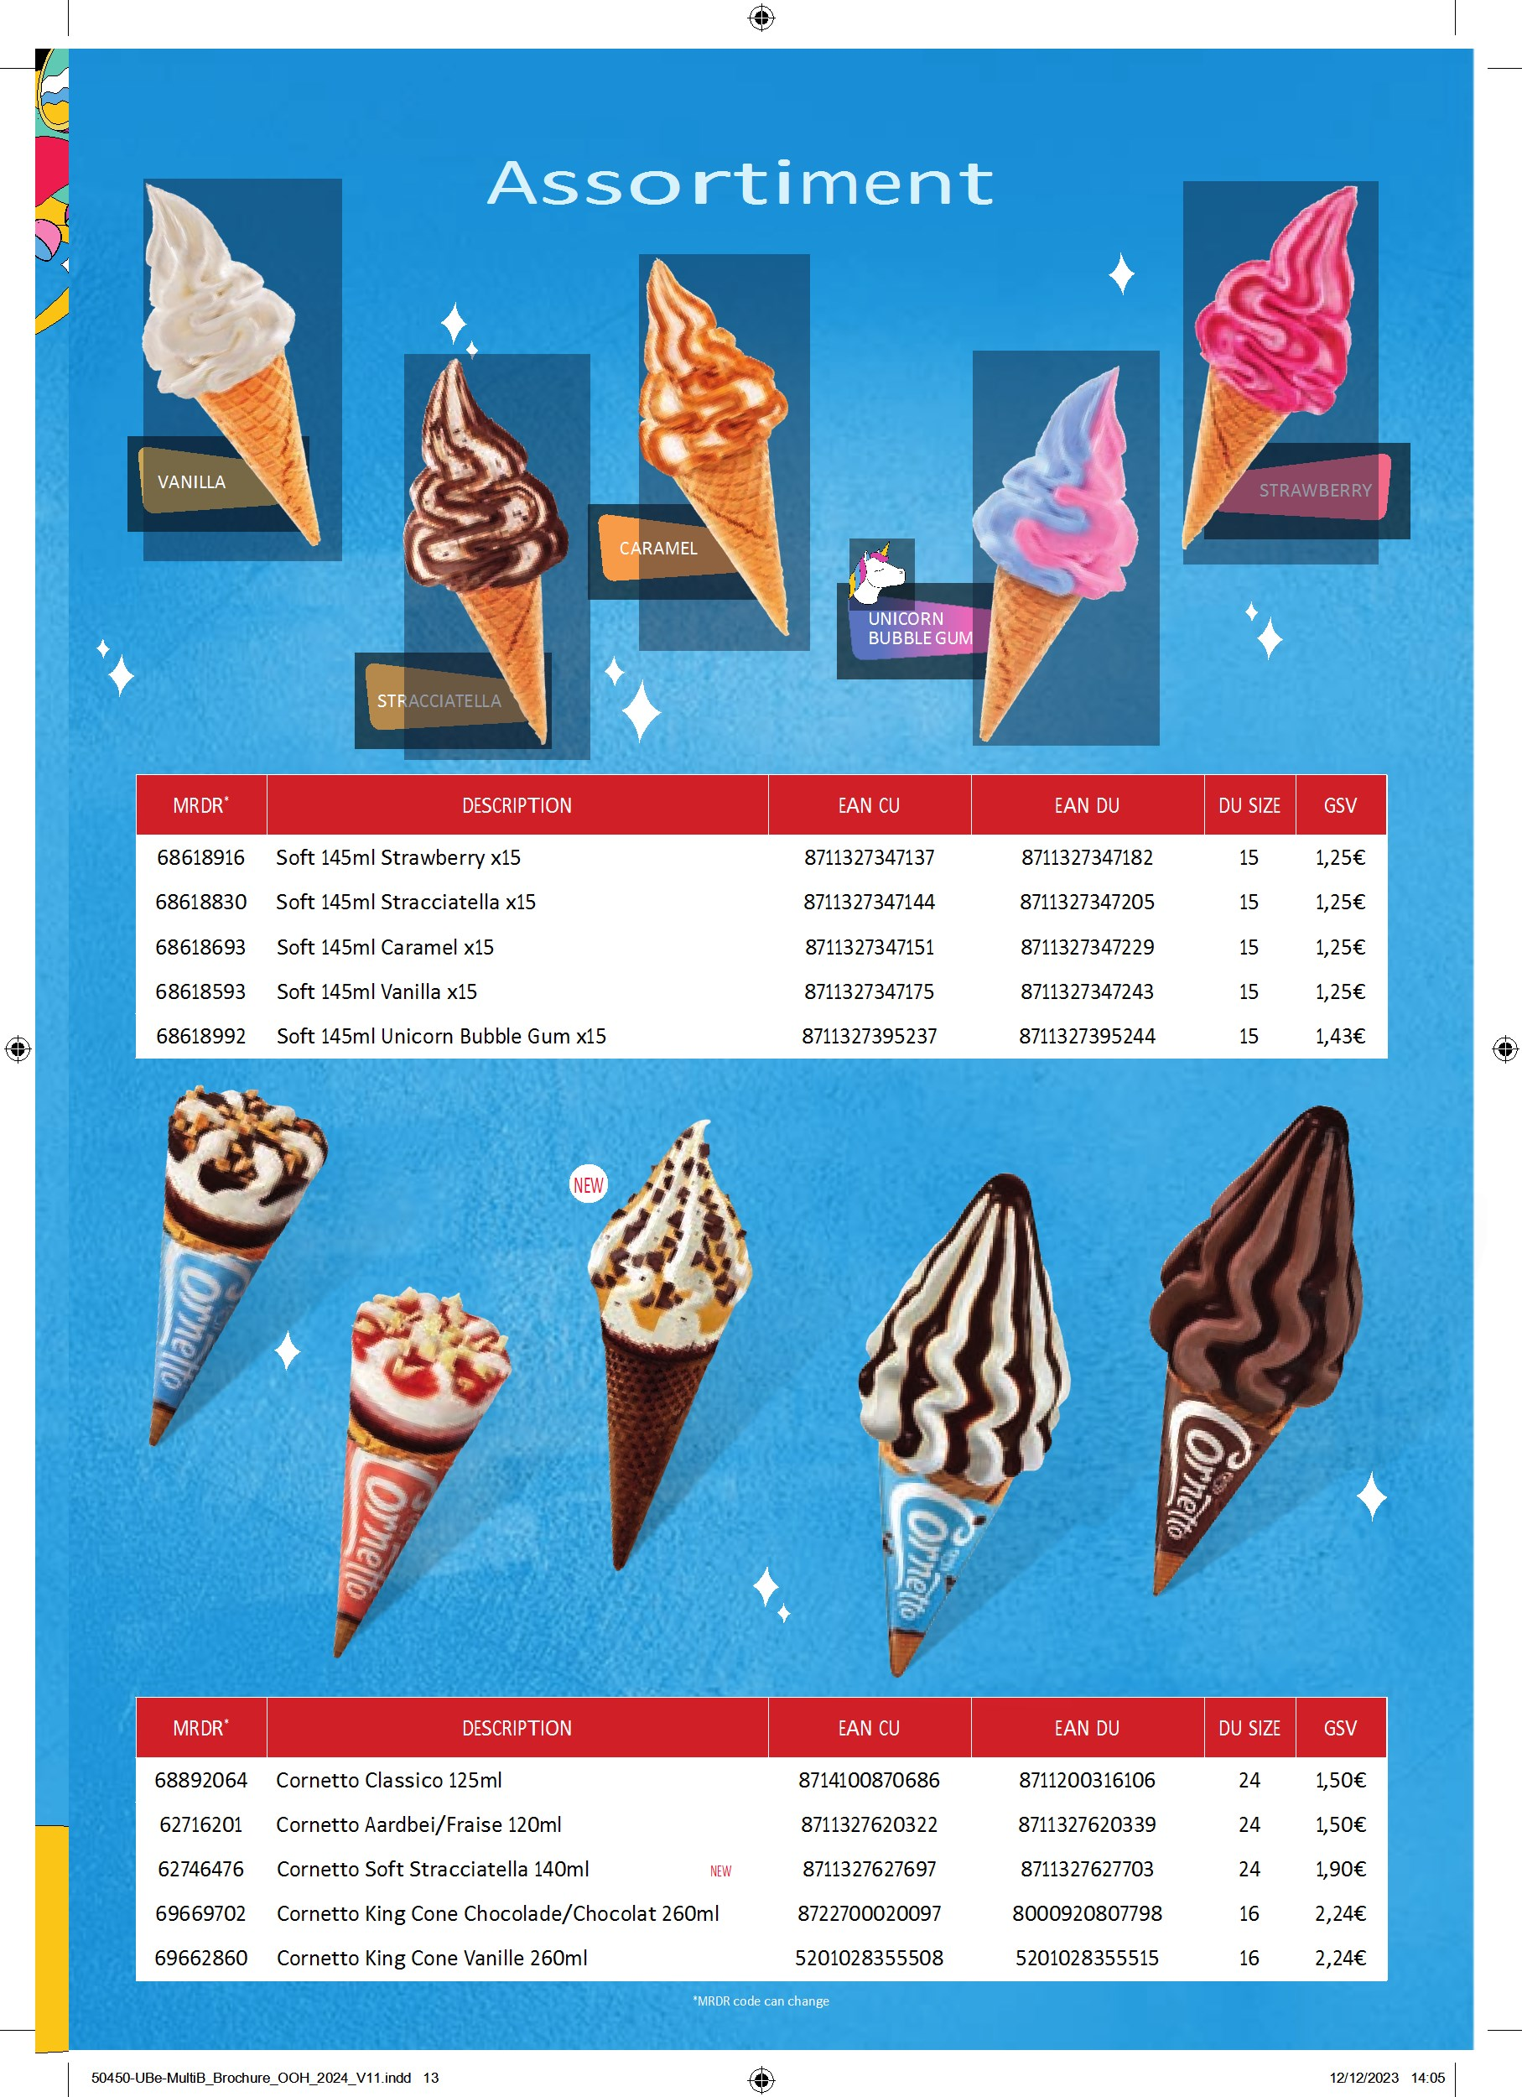

Slide 13
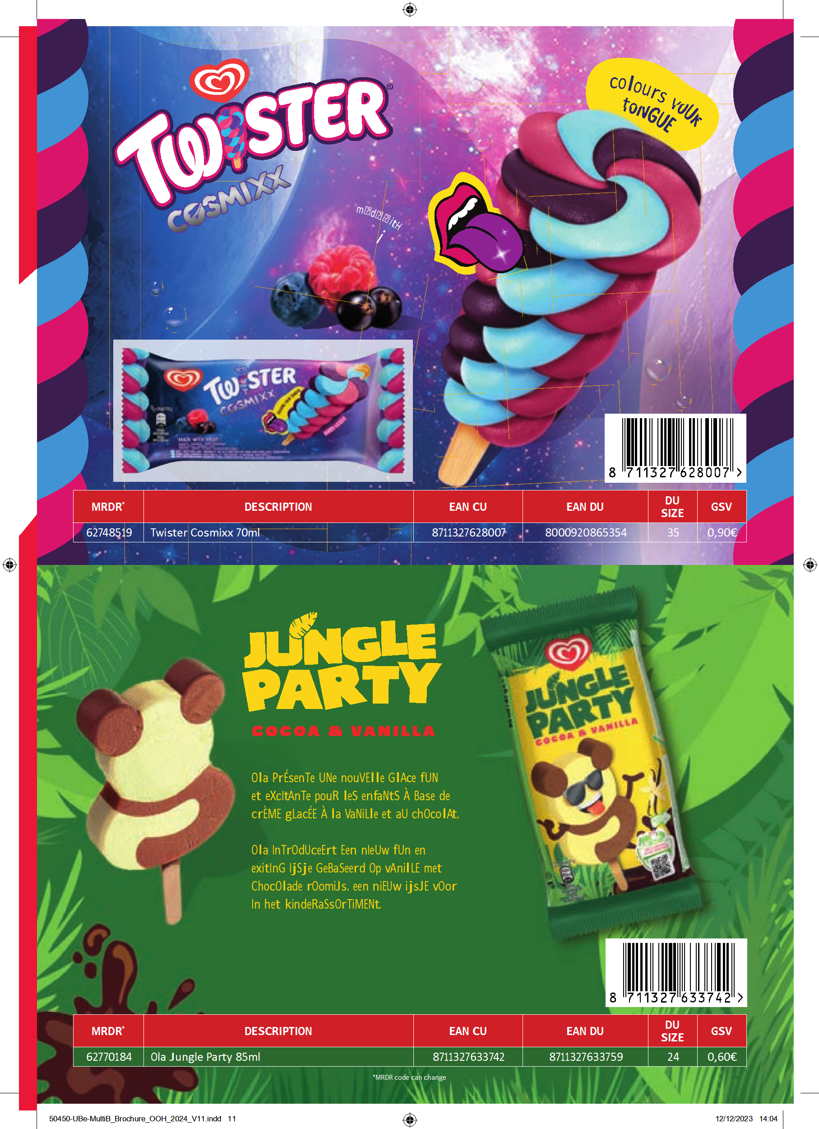

Slide 14
Seasonstart 2024 Ola
Streetvendors
Febr – March
Ola March
Ola April
10+2
  Magnum Euphoria: 2x
39+10
  Magnum Euphoria: 5x
  Calippo Orange/Cola: 5x
78+22
  Magnum Euphoria: 5x
  Calippo Orange/Cola: 12x
  Magnum Classic: 5x
6+1
  Magnum Euphoria
10+2
  Magnum Euphoria
  Cornetto Classic
14+4
  Magnum Euphoria
  Cornetto Classic
  Calippo Orange/Cola
  Ola Raket
6+1
  Magnum Euphoria
10+2
  Magnum Euphoria
  Cornetto Classic
14+3
  Magnum Euphoria
  Cornetto Classic
  Calippo Orange/Cola

Slide 15




Seasonstart 2024 Ola

Slide 16
Seasonstart 2024 B&J’s
B&J’s shorties March
B&J’s shorties April
B&J’s pints March - April
4+1
  Cookie Dough
8+3
  Cookie Dough: 3x
4+1
  Cookie Dough
- Retail promo plan
- No seasonstart on B&J’s pints

Slide 17



Seasonstart 2024 B&J’s

Slide 18
Seasonstart 2024 Cornetto Soft
Cornetto Soft March - April
4+1
  Vanilla

Slide 19
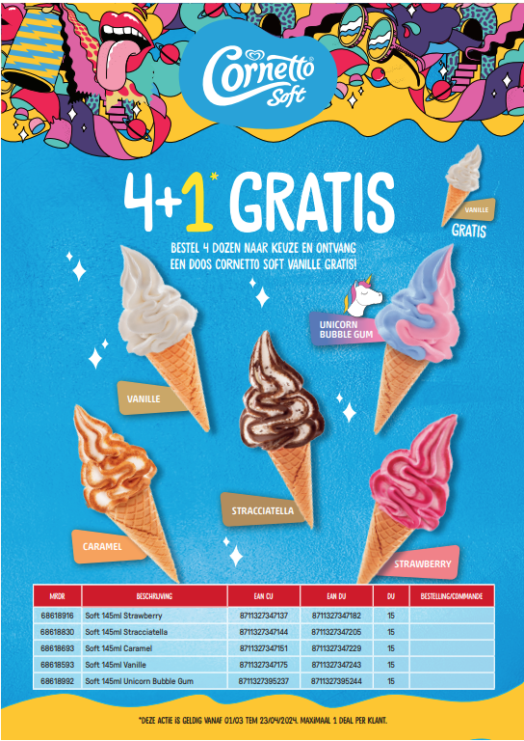
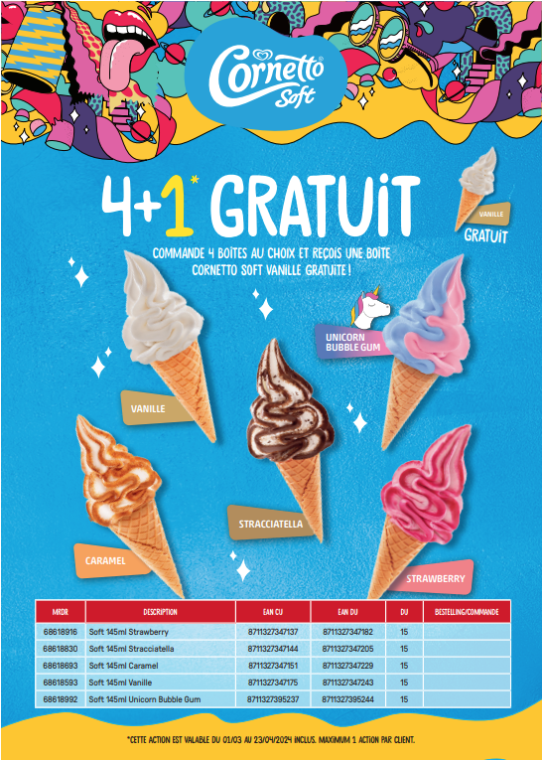

Seasonstart 2024 Cornetto Soft

Slide 20

Recap Seasonstart 2024
Orders max 3x
2024
jan
feb
mrt
apr
mei
Activiteit
01
02
03
04
05
06
07
08
09
10
11
12
13
14
15
16
17
18
19
20
21
22
Gratis
OLA
Holidays FR part of BE
10+2 – 39+10 – 78+22
Magnum Euphoria, Calippo, Magnum Classic
6+1
Magnum Euphoria
10+2
Magnum Euphoria, Cornetto Classic
14+4
Magnum Euphoria, Cornetto C, Calippo, Raket
14+3
Magnum Euphoria, Cornetto C, Calippo
B&J’s & Cornetto Soft
Holidays FR part of BE
B&J’s shorties 4+1 – 8+3
4+1 – 8+3
4+1
Cookie Dough
Cornetto Soft 4+1
Vanilla

Slide 21
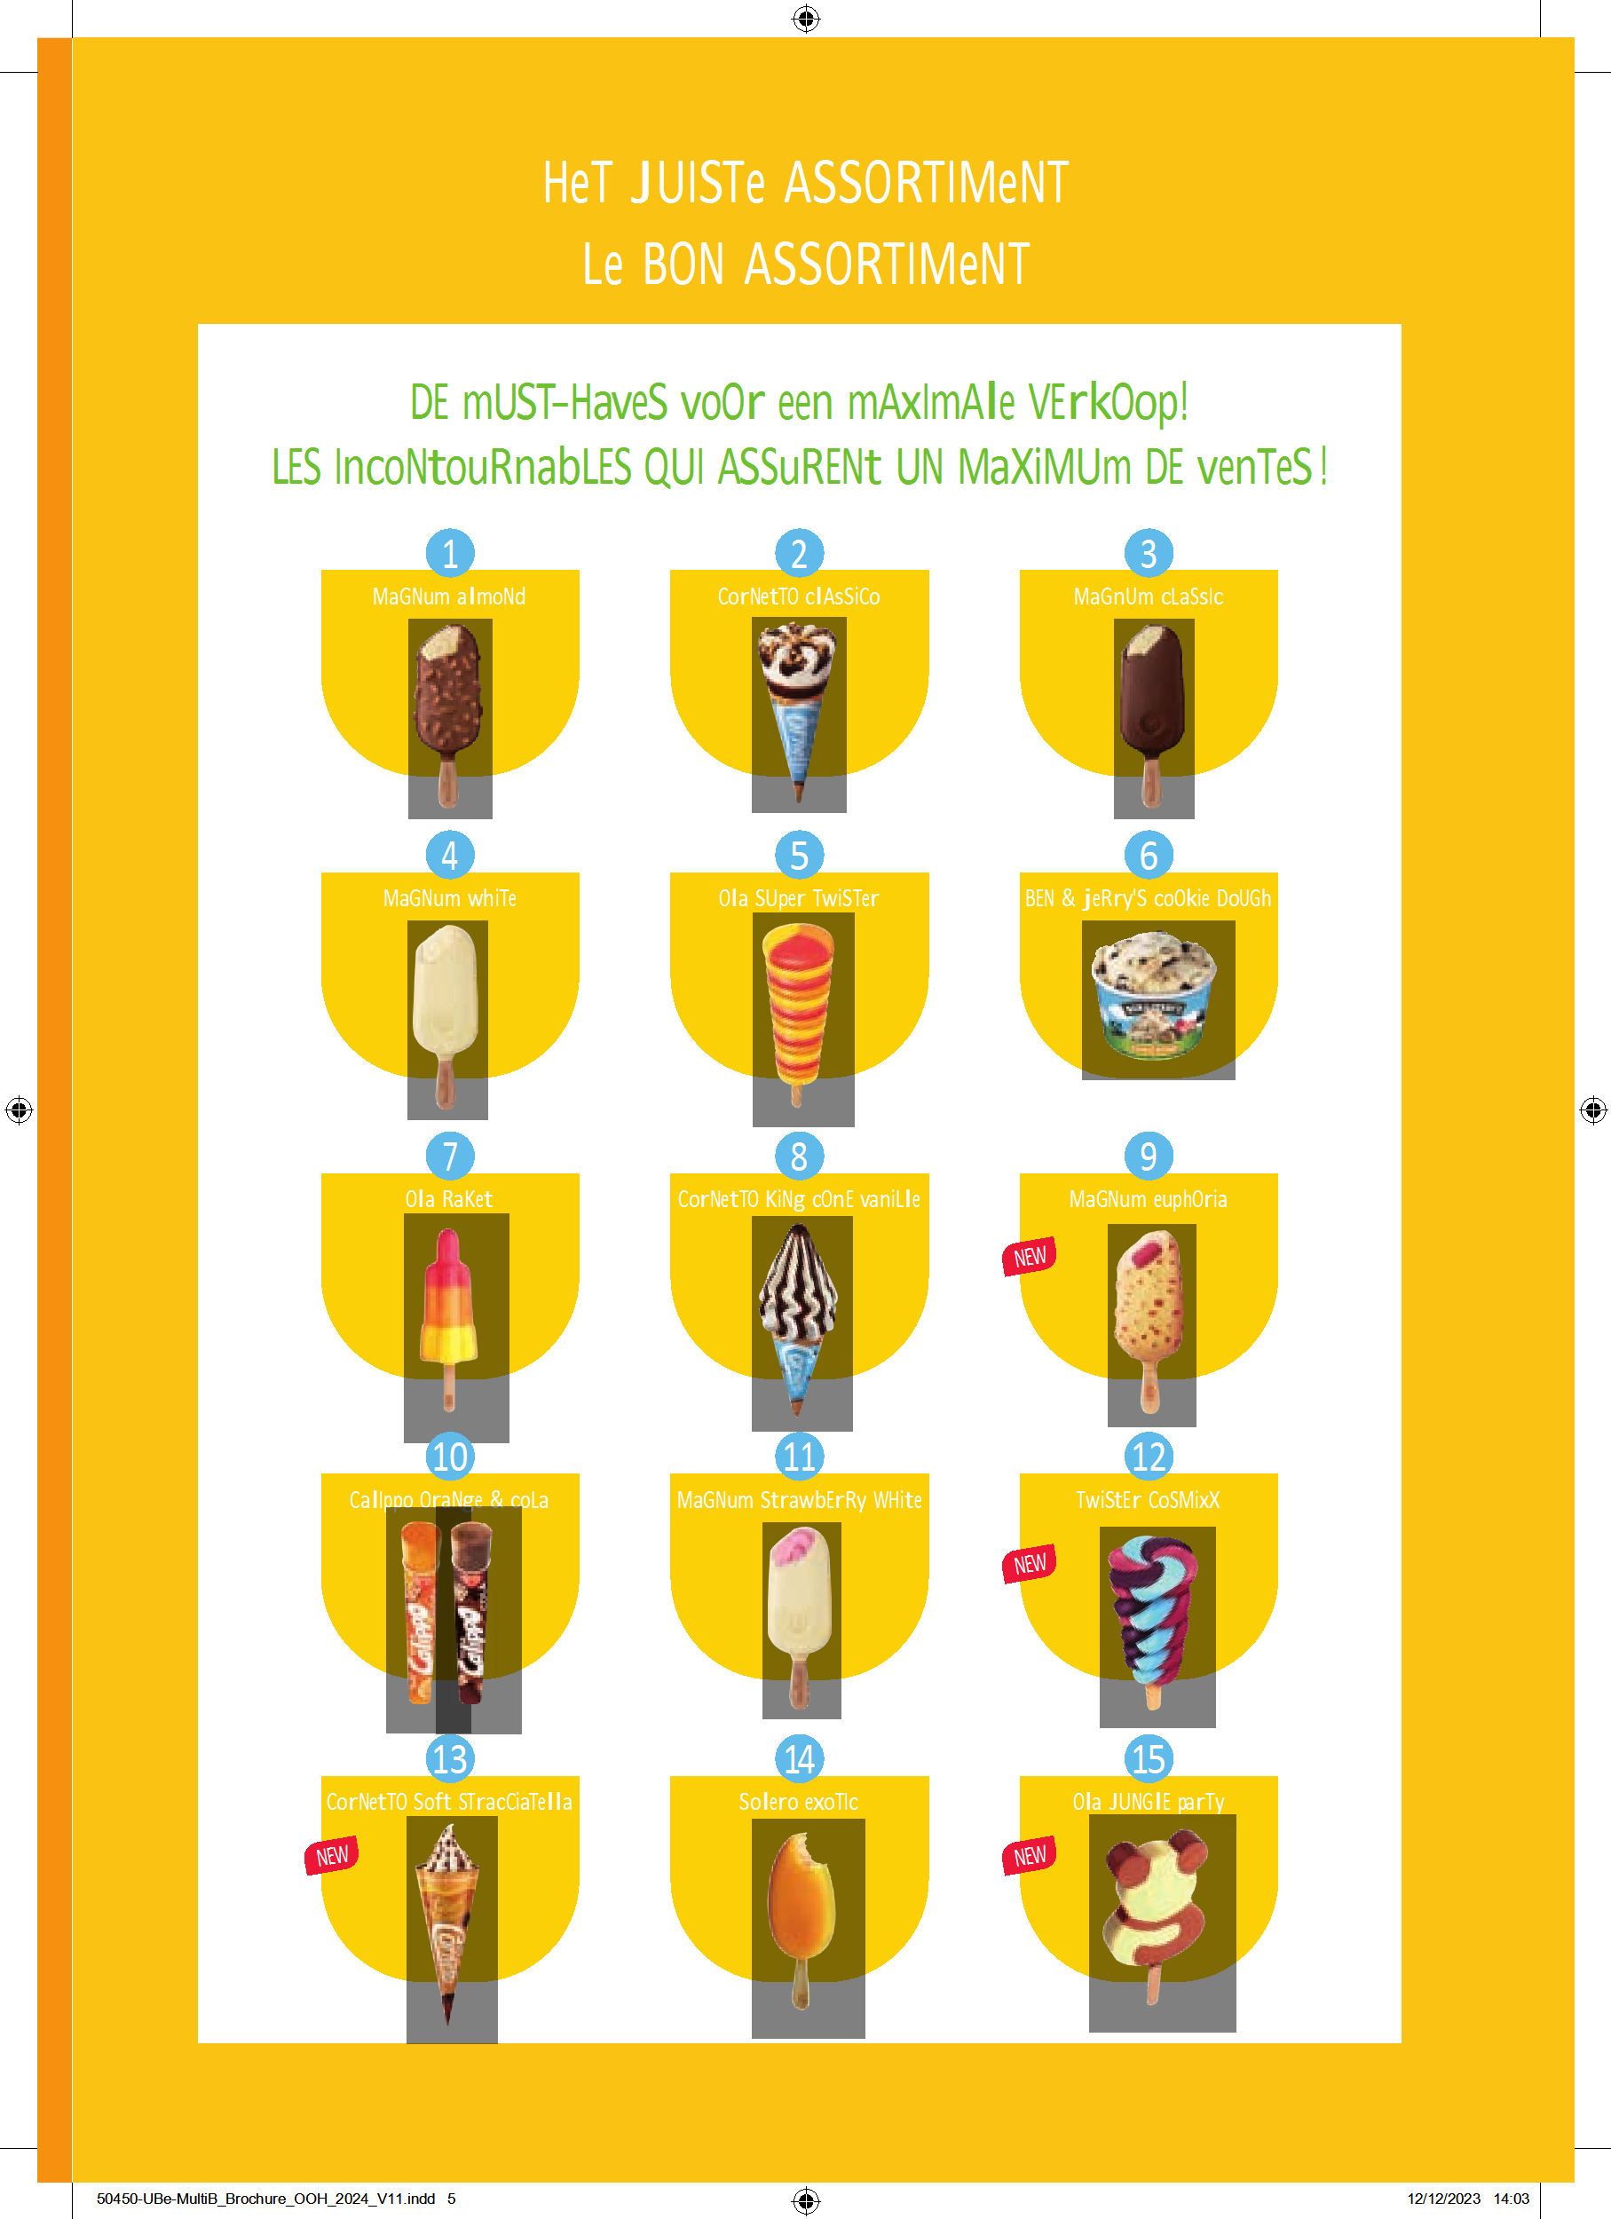

Slide 22
